Slide 1
MILESTONE - 4

Slide 2


Team 1
Food Brand Understand Customer Trends

Slide 3

OUR TEAM
01. Ganji Sindhu Priya
02. Parul Gautam
03. Varanasi Vinaykumar
04. Rohan Raj
Under the Guidance of
PAVITRA KANNAN

Slide 4

OVERVIEW
Introduction
Project Overview
-> Key Features
-> Tech Stack
-> Milestones
Conclusion

Slide 5

INTRODUCTION
Project Overview:
This project focuses on analyzing customer behavior through segmentation and persona-based insights. It identifies Loyal Fans, Critics, and Silent Users to understand engagement levels, satisfaction, and feedback trends using Power BI and DAX.
Core Functionalities
Dynamic segmentation and persona classification using DAX Logic.
Interactive dashboard with multi-level filters for region, channel, and segment.
Visual storytelling to uncover satisfaction patterns and engagement frequency.
Outcomes
The analysis enabled a deeper understanding of customer satisfaction and loyalty patterns, helping identify key improvement areas and drive data-informed marketing strategies.

Slide 6

PROJECT OVERVIEW
Key Features:
Designed a Customer Persona Model to classify users into Loyal Fans, Critics, and Silent users.
Implemented interactive Power BI visuals for real-time behavior insights.
Built KPI cards, scatter plots, and maps for dynamic persona analysis.
Integrated filters for region, segment, and channel to enable detailed exploration.

Slide 7
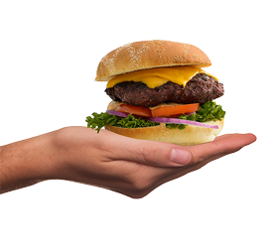
TECH STACK
Power BI: Primary tool for developing interactive dashboards to visualize sentiment trends and insights across regions, channels, products, and customer segments.
DAX (Data Analysis Expressions): Used to calculate sentiment KPIs (% Positive, % Negative, % Neutral) and derive measures for trend analysis and comparisons.
Microsoft Excel: Utilized for data cleaning, preprocessing, and formatting to ensure seamless integration with Power BI.

Slide 8


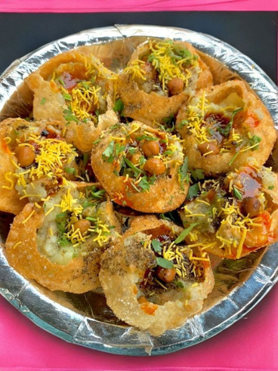
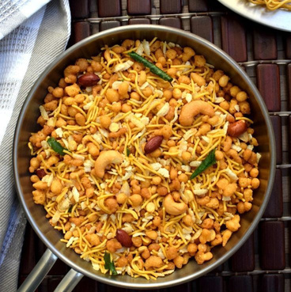
MILESTONES
01
02
03
04
05
Data Collection & Cleaning
Gathered dataset and ensured accuracy through preprocessing.
Feature Engineering
Created measures and customer segments (New, Regular, Loyal).
Sales & Product Dashboard
Built interactive dashboards for sales and product insights.
Customer Insights Dashboard
Analyzed customer demographics, segmentation, and loyalty.
Trends & Recommendations
Identified key trends and suggested strategic improvements.

Slide 9

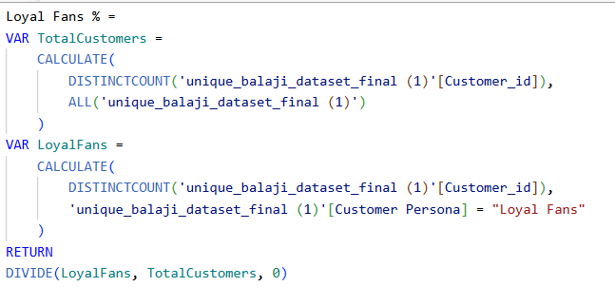
DAX Measures for Customer Segmentation & Persona Classification

Slide 10
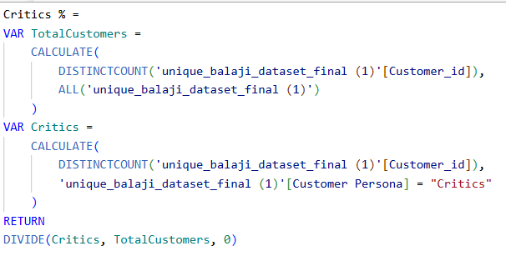
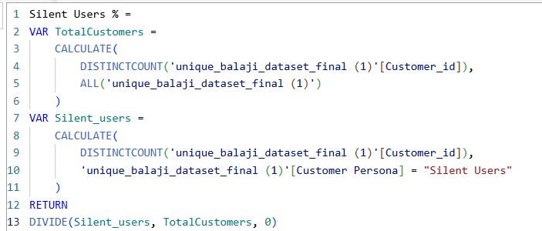


Slide 11
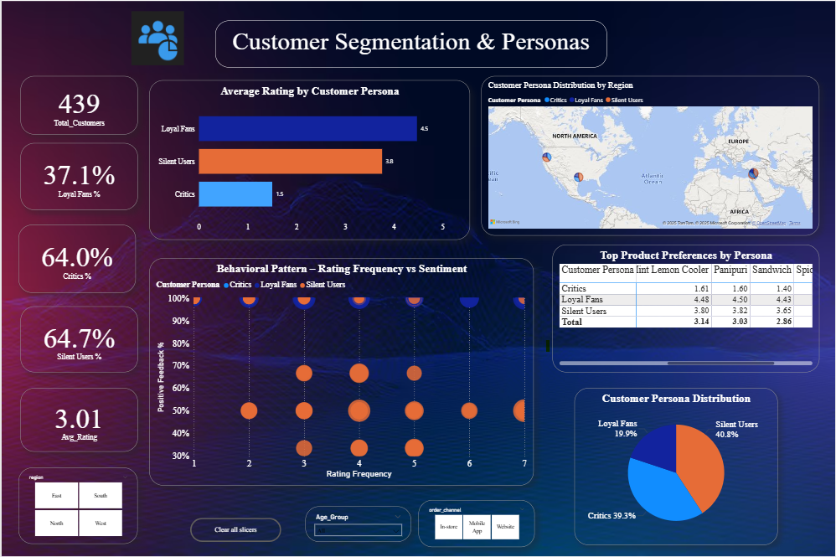
Customer Segmentation & Persona Insights Dashboard

Slide 12
CONCLUSION
This milestone successfully highlights how persona-based segmentation can drive customer understanding and retention.
By visualizing loyalty patterns, regional behavior, and engagement trends, the project provides clear insights for strategic decision-making.
In future, incorporating AI-driven predictive sentiment analysis and automated loyalty scoring models can further enhance the accuracy of customer profiling and personalization efforts.

Slide 13
Thank You

